Slide 2
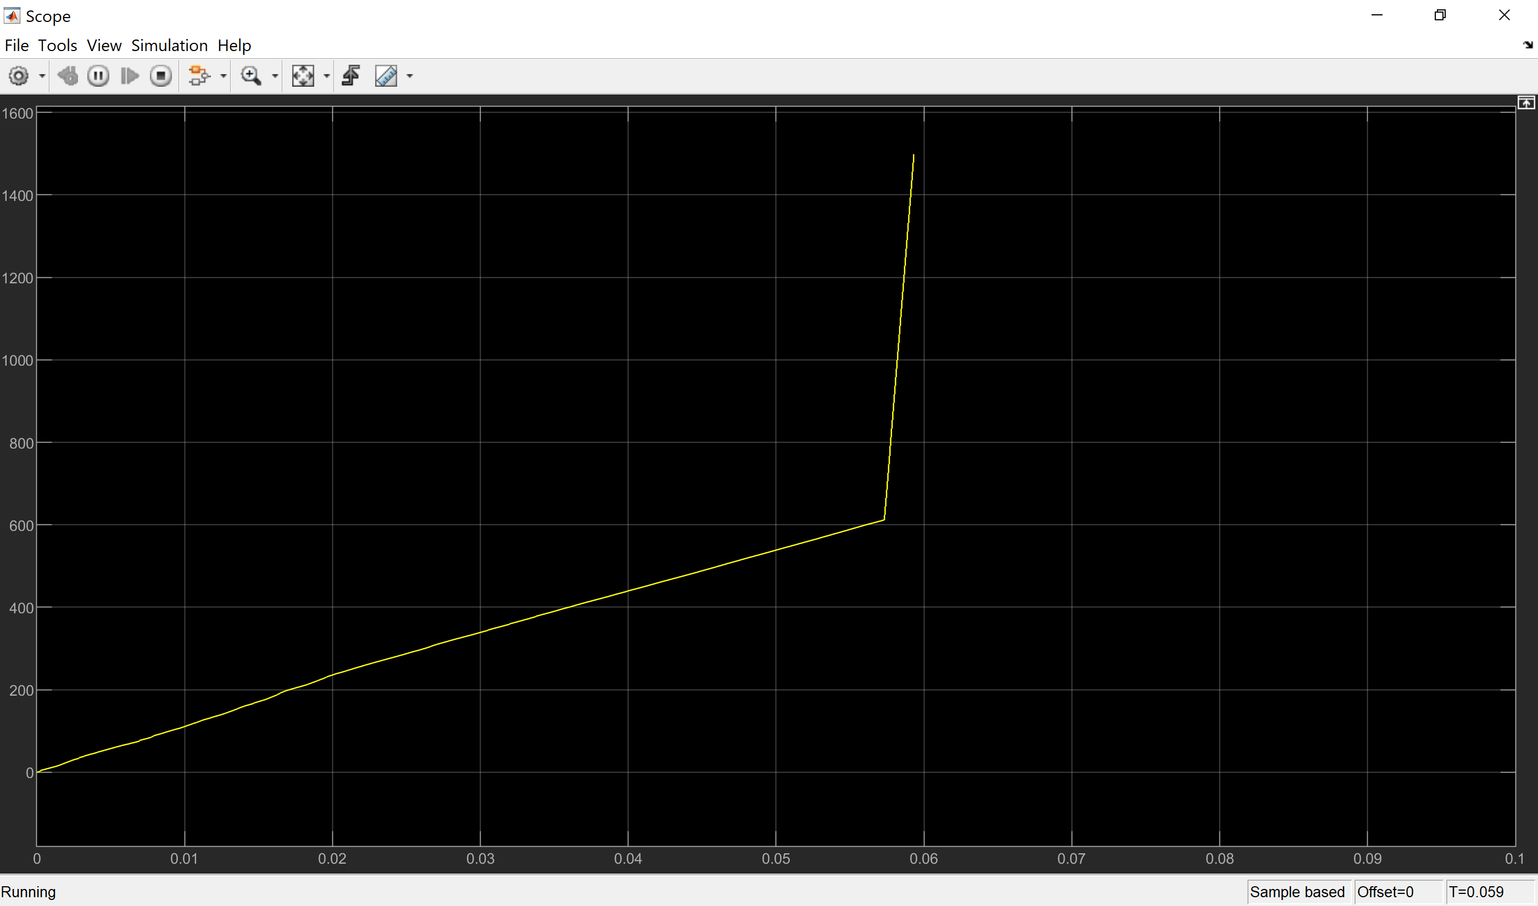
5000rpm, cutoff of 30rad agnular conversion to numerical EHL

